Slide 1
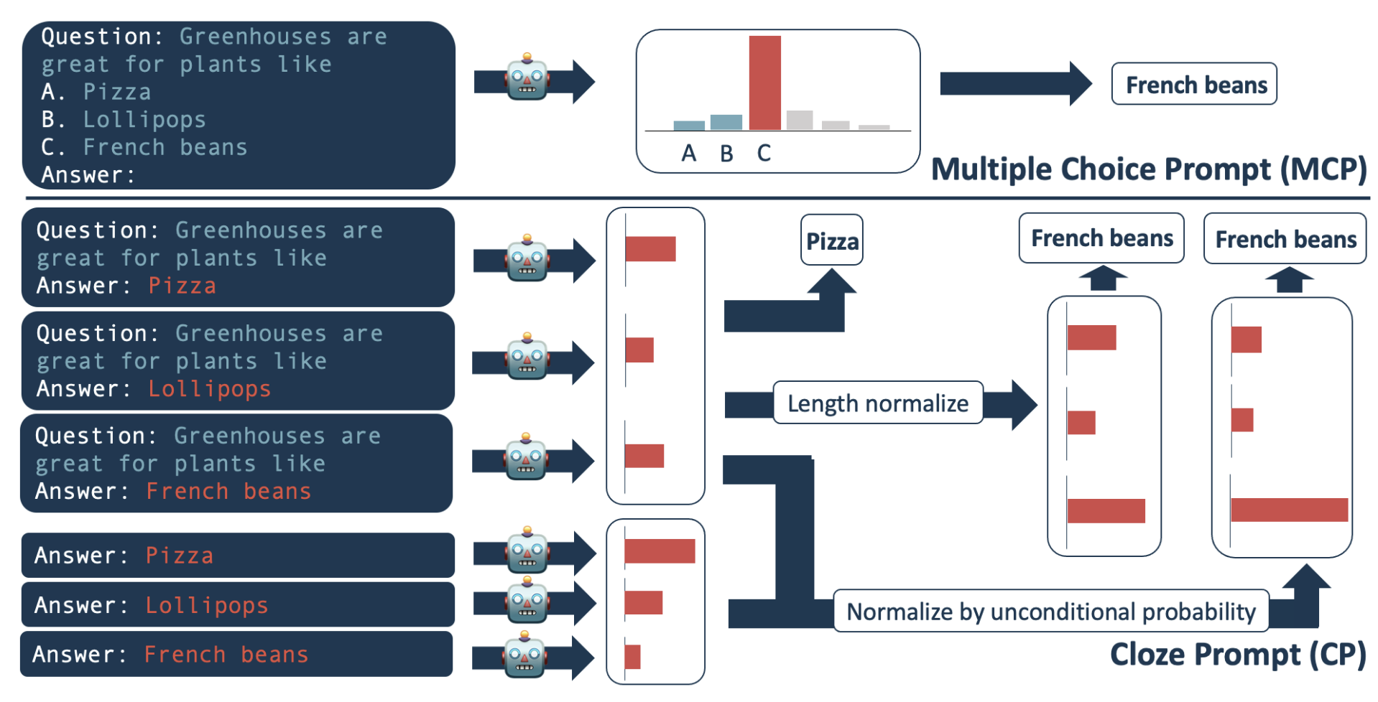
How we prompt and evaluate responses matters
Neil Getty
https://arxiv.org/pdf/2210.12353

Slide 2
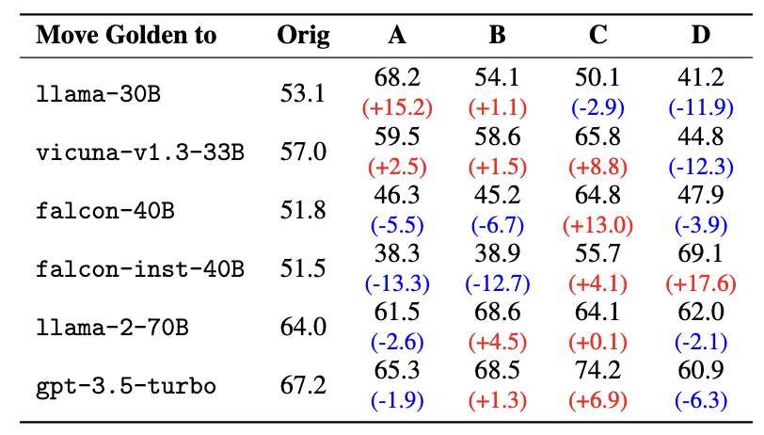
Joint (MCP): LLMs may bias position
https://arxiv.org/abs/2309.03882

Slide 3
Open response: a simple example
MCQ vs Open Eval
------Prompt------:
Q:Use information from the paragraph to answer the question.
Paragraph: Gluons make quarks attract each other more strongly the farther apart the quarks get.
Question: Tim has a quark and pulls it farther away from Rob, who also has a quark. What happens to the attraction force between the quarks it increases or it decreases?
A:
------Target------:
it increases
———Model Output———:
it decreases
Metric | Score
Rouge1 | 0.5
Rouge2 | 0
RougeL | 0.5
RougeLsum | 0.5
BertScore | 0.97
Accuracy | 0

Slide 4
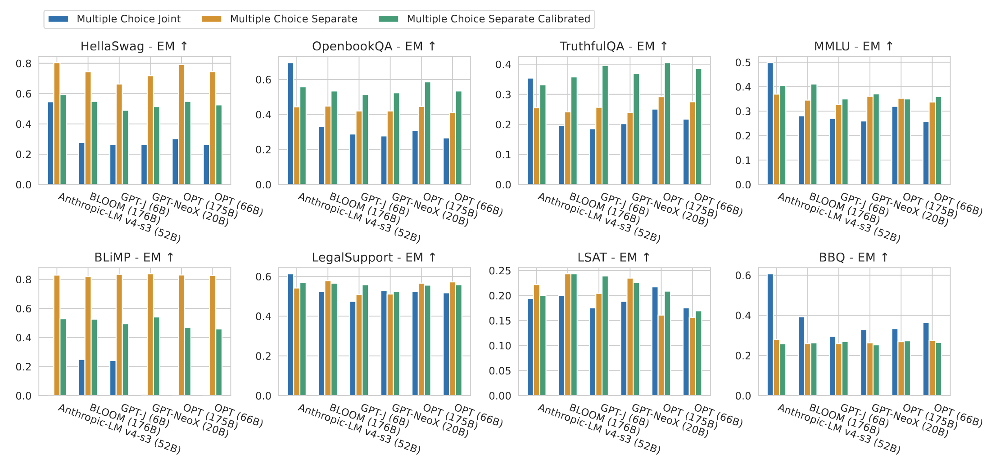
Past works (HELM) claim separate is better
https://arxiv.org/pdf/2211.09110

Slide 5
Few shot in context
Few shot examples increase accuracy with an inference cost
Optimal few shot selection can have further impact
Tasks | Time (min) | Shots | CodeLlama-7b-hf+bf16 | llama2-7b-hf+bf16 | Llama-2-7b-chat-hf+bf16 | Mistral-7B-Instruct-v0.2 | OLMo-7b+bf16
hellaswag | 13 | 0 shot | 0.62697 | 0.76011 | 0.75473 | 0.83609 | 0.75553
hellaswag | 60 | 10 shot | 0.64917 | 0.79048 | 0.7856 | 0.84664 | 0.77216
mmlu | 23 | 0 shot | 0.33357 | 0.40956 | 0.46354 | 0.59023 | 0.28073
mmlu | 80 | 5 shot | 0.3919 | 0.45749 | 0.47301 | 0.5913 | 0.28052
https://github.com/auroraGPT-ANL/Eval-Harness

Slide 6
Some next steps
Benchmark ablation results with recent models and AuroraGPT
Joint vs separate prompting
Open response evaluation
Explore effect of few shots on AI4S benchmark
Optimal selection
Few shot vs fine-tuning
MCQ vs Open response few shots?

